Slide 1
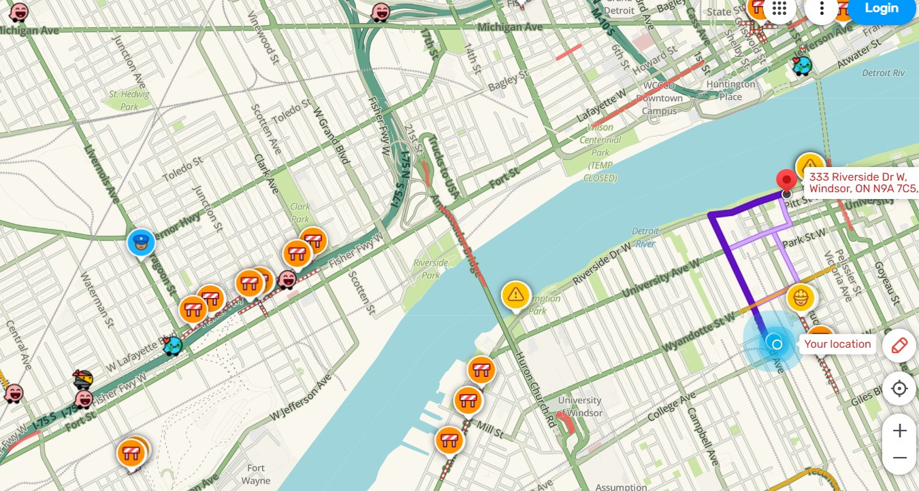
Waze
Avoiding the Exit Ramp: Retention Strategies for Waze Users

Slide 2
What is Waze?
Waze is a community driven navigation app that provides real-time traffic information and turn-by-turn directions. It was founded in 2008 and acquired by Google in 2013 for $ 1.1 billion.
Market Share and User Base
  Waze has over 140 million monthly active users worldwide.
  It’s the second most popular navigation app after Google Maps

Slide 3
Why User Retention is Important?
  Data Quality:
Waze's effectiveness relies on active users consistently providing real-time traffic updates. Higher retention means more accurate and up-to-date information.
  Network Effects:
The value of Waze increases with more active users. Retaining users strengthens its network effects, making the app more valuable for all users.

Slide 4
Mapping the Exit: How Bad is User Churn?

Slide 5
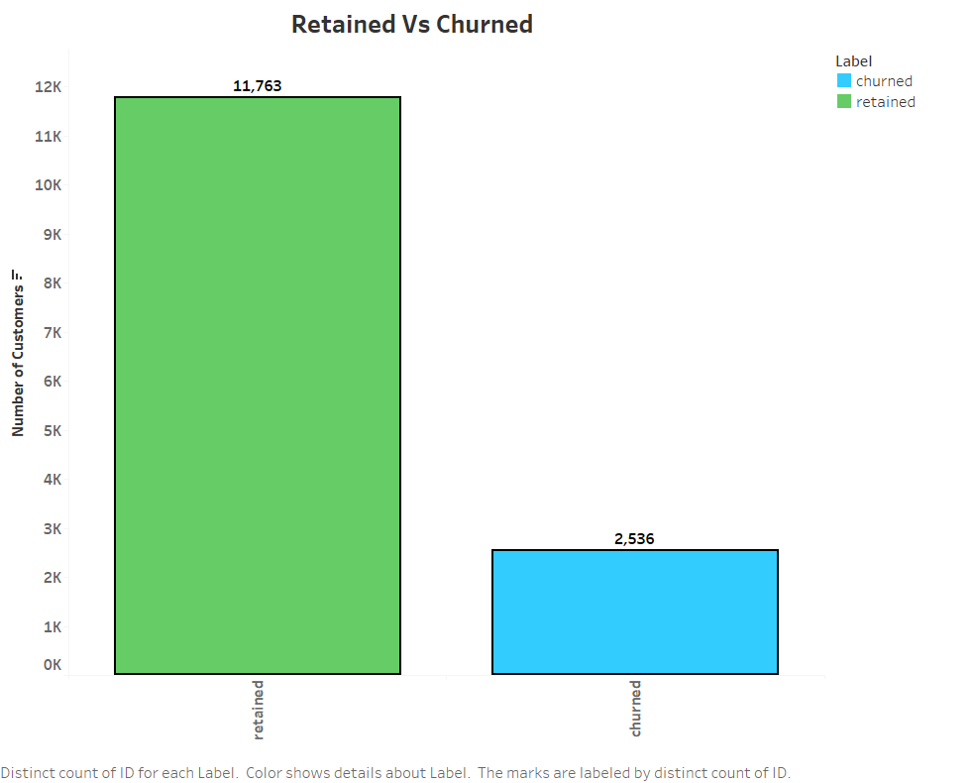
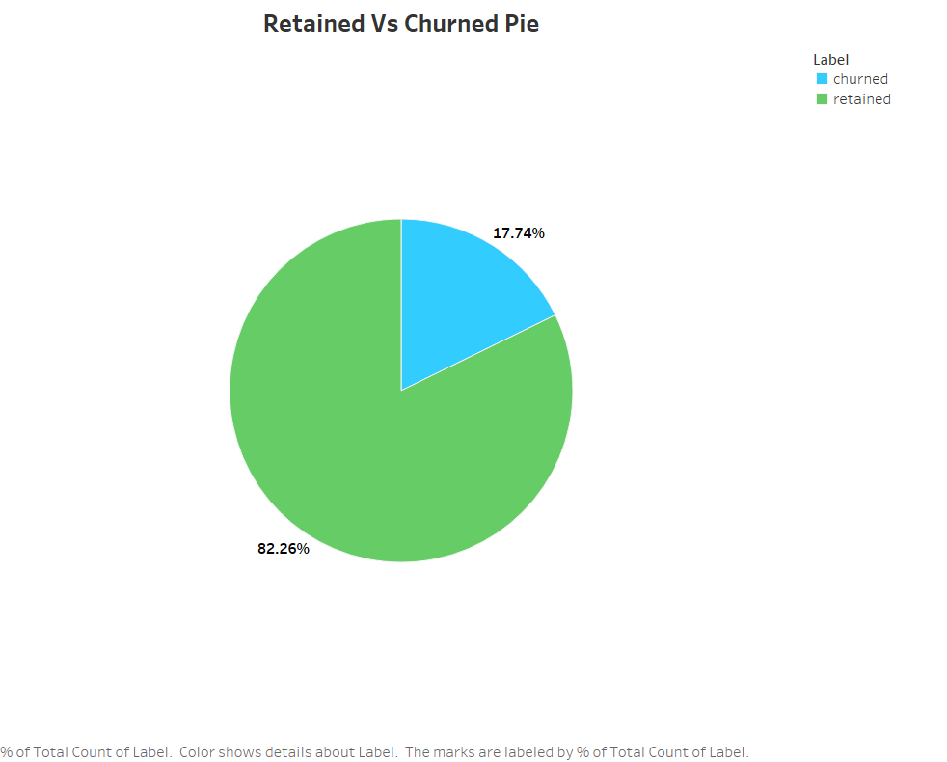
We’ve Lost 17.74% of Our Users !

Slide 6
Who’s in the Driver’s Seat? Exploring Waze’s Customer Base

Slide 7
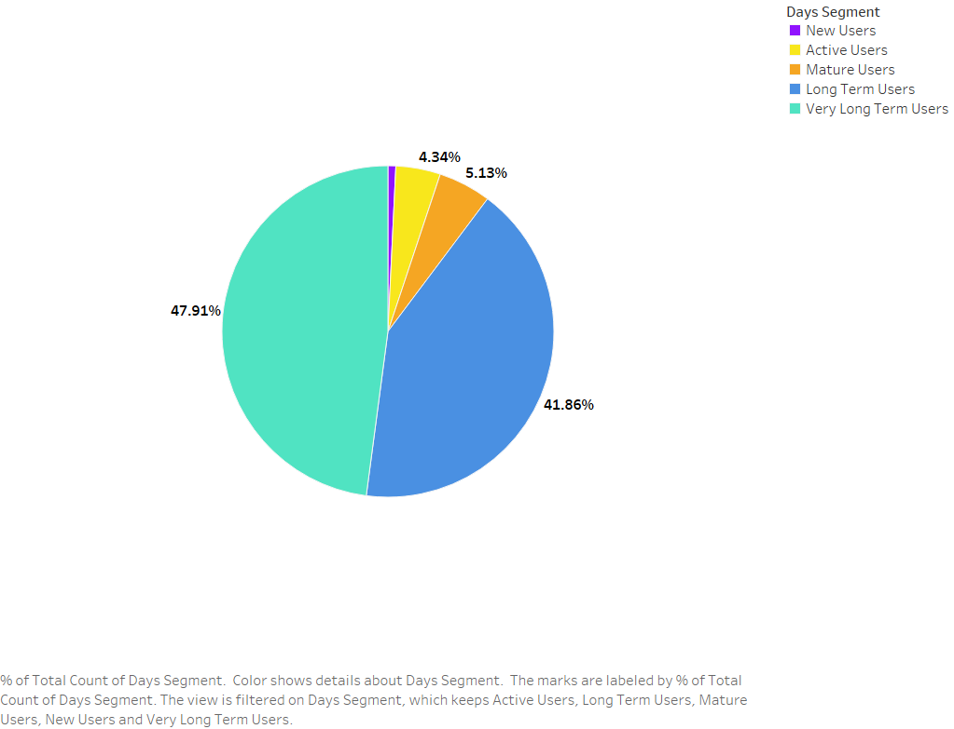
A Loyal Base, But Where Are the New Users?
What Can We Do?
  Simplify Onboarding: Provide clear tutorials or step-by-step navigation.
  Gamify Onboarding: Offer rewards for completing setup and first reports.
  Welcome Campaigns: Use personalized notifications and email follow-ups.
  Partner Promotions: Collaborate with businesses to attract first-time users.

Slide 8
Who’s Taken the Exit? Understanding Our Lost Users

Slide 9
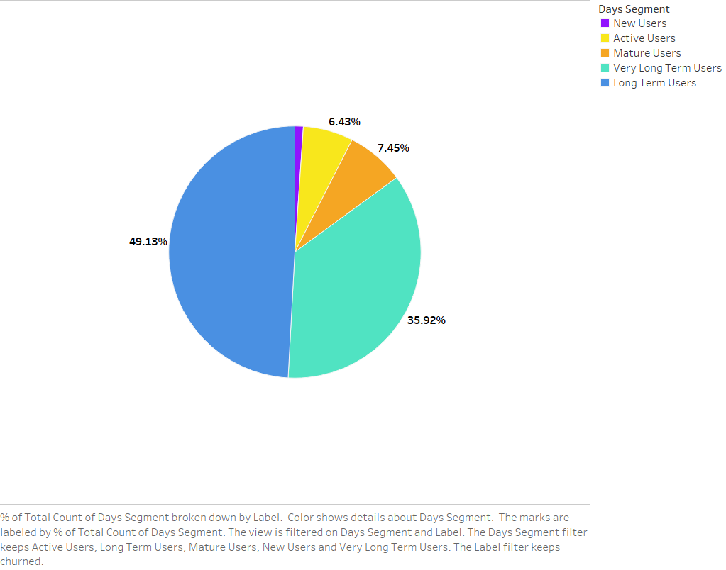
Losing Our Foundation: A Deep Dive into Churn Among Long-Term Users
What can we do?
  Re-Engagement Strategies:
    Personalized win-back campaigns targeting churned users.
    Highlight new features or fixes to address past pain points.
    Offer exclusive incentives for reactivation.
  Retention Strategies for Remaining Users:
    Invest in user experience improvements.
    Gather feedback to understand unmet needs.

Slide 10
Driving Less, Using Less: Spotting Early Warning Signs of Churn

Slide 11
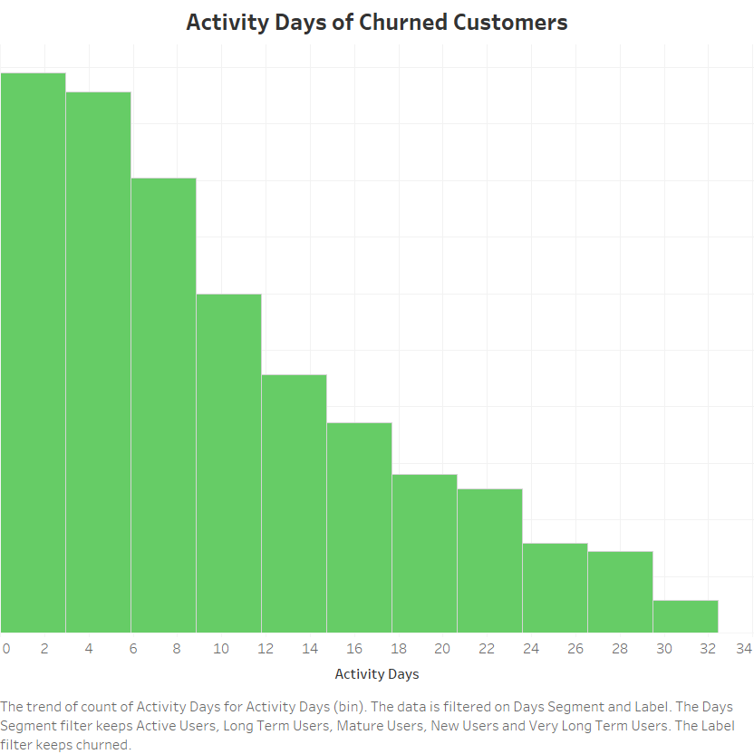
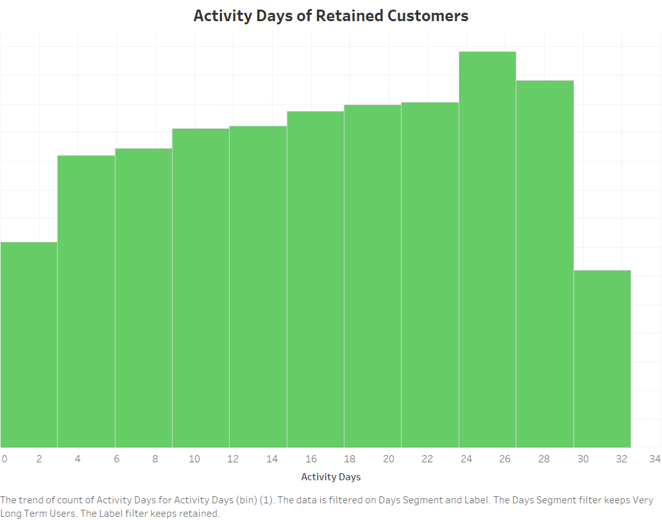
Low Activity, High Risk: Understanding Churn Drivers

Slide 12
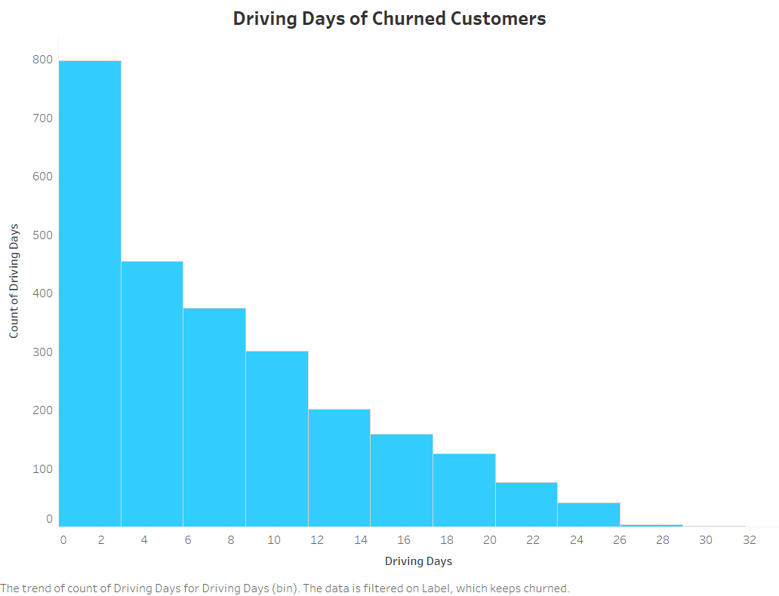
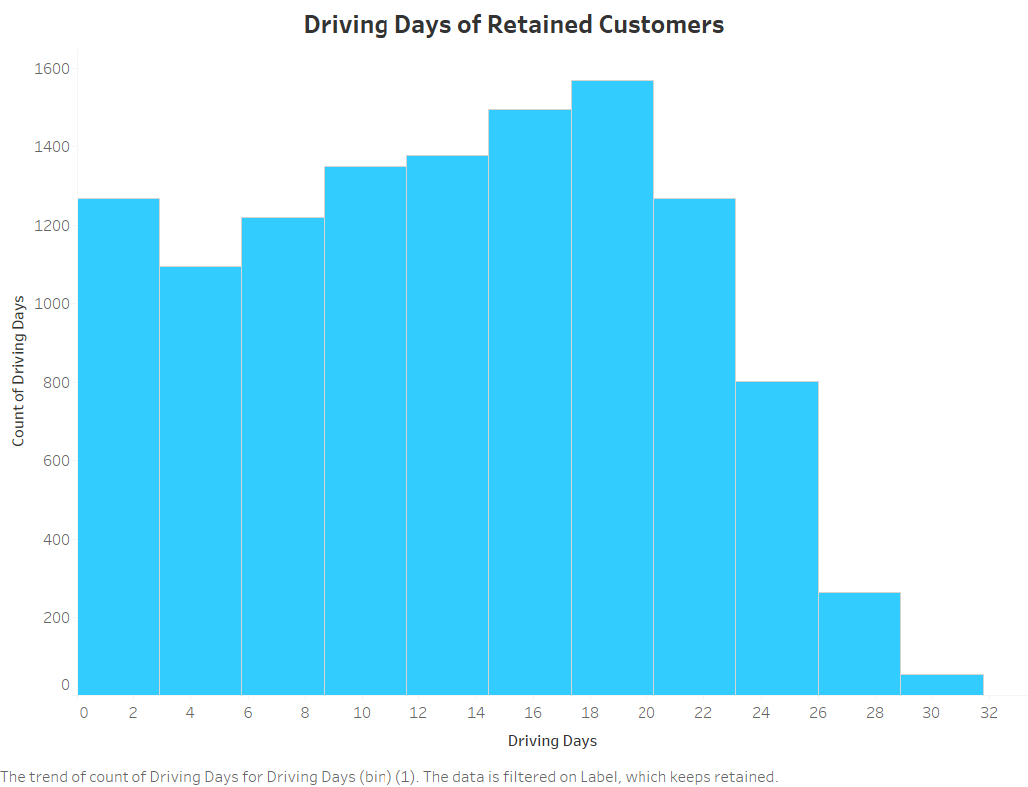
Driving Less, Leaving More: The Churn Connection

Slide 13
Recommendations
  Retain Long-Term Users (Primary Focus)
  Improve Onboarding for New Users
  Proactively Address Early Signs of Churn
  Broaden User Base and Diversify Offerings
Let’s Drive Retention and Reignite Growth!
  Focus efforts on strengthening loyalty and boosting engagement.
  Use insights from churn analysis to create proactive, data-driven strategies.

